Slide 1
Data Visualization Principles
Shannon Haymond

Slide 2
Lesson Goals
Identify types of common data visualizations that are most appropriate given the types of data available and the goal of the analysis
Lesson Objectives
Describe at least 2 scenarios in which a plot is more effective than a table in demonstrating relationships between variables in a data set
For each possible combination of data types, identify a type of plot that will effectively illustrate the relationship between two variables
List 2 types of plots that can illustrate statistical uncertainty when comparing numeric values between groups.

Slide 3
Purpose of Visualizations
Communicate — tell a clear story that can be more inclusive
Discover — fast exploration of assumptions, surface patterns, outliers, and data-quality issues
Compare & Relate — show differences, trends over time, and relationships between variables
If done well, visualization can build trust and drive action
Notes:
Shannon
Focus here is on communication and more specifically of quantitative information – is this true?? Case 2 Is more analysis focused, right?
— provide transparency and understanding for monitoring, interventions, and outcomes

Slide 4

But when done wrong, can be harmful
Common mistakes:
Data misrepresentation or quality issues
Misusing and overcomplicating charts
Misleading color, elements, axes, and scales
Bad outcomes:
False conclusions lead to bad decisions
Reduced clarity erodes understanding and raises skepticism

Slide 5
Data visualization best practices
Match visual to purpose & data type
01
Make comparisons effortless
02
Use effective visual encodings
03
Design for readability & accessibility
04

Slide 6
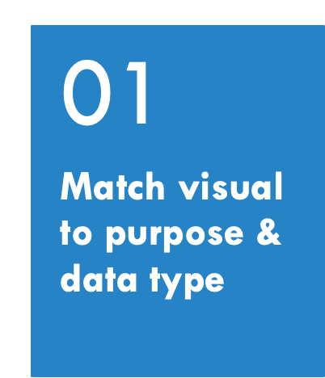
What is the purpose of the visualization?
  High level exploration and discovery
  Deeper level of comparison and understanding relationships
What type(s) of data will be visualized?
  Quantitative vs qualitative

Slide 7
Discover: Exploratory Data analysis
Goal is to show shape and distribution of data with obvious patterns and data quality issues
Insight into spread of data, outliers, general shape and distribution
Investigate single columns of data, maybe some basic relationships
Do your assumptions hold? Are there data quality issues?

Slide 8
What types of visualizations show data distributions?
Poll

Slide 9
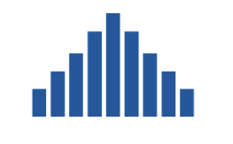
Histograms provide insight into distribution
Type of bar chart used to visualize distribution of quantitative data
Typically focuses on a single variable
Requirement: define bins for x-axis
Y-axis represents the count or frequency within the bin

Slide 10
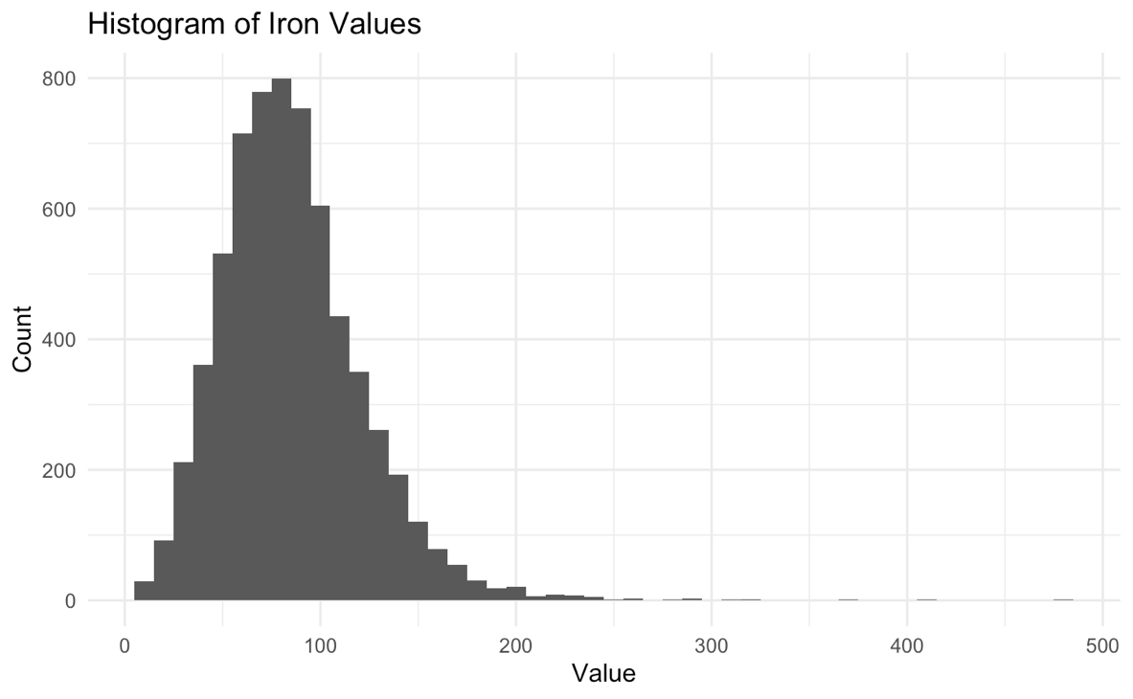
Example: histogram of iron values
Positive kurtosis
Bins 10 mcg/dL wide
Number of observations
Positive skew
Numeric variable of interest
Notes:
Dimension:
Skewness describes a distribution's horizontal spread and balance, while kurtosis describes its vertical spread and the presence of outliers.
Symmetry vs. Tails:
Skewness tells you about the symmetry around the mean, while kurtosis tells you about the concentration of data in the tails.
Comparison to Normal Distribution:
A distribution close to normal has skewness near 0 and an excess kurtosis near 0.
Leptokurtic (positive excess kurtosis): A higher, sharper peak and fatter tails than a normal distribution, indicating a higher concentration of data around the mean and more extreme values

Slide 11
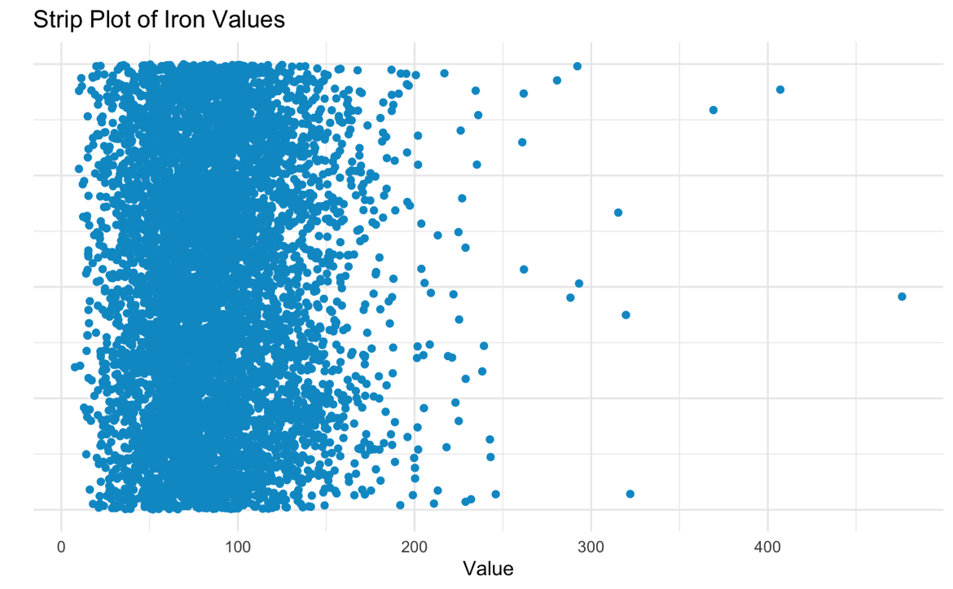
Strip plots show every point in a distribution
High density may obscure number of observations
Single observation
Numeric variable of interest

Slide 12
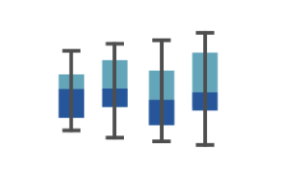
Boxplots also a way to visualize distributions
Subset a continuous (numeric) variable by a qualitative variable
Incorporates a statistical summary of data, though distribution may be “abstracted” by box plot
Useful for comparing across groups

Slide 13
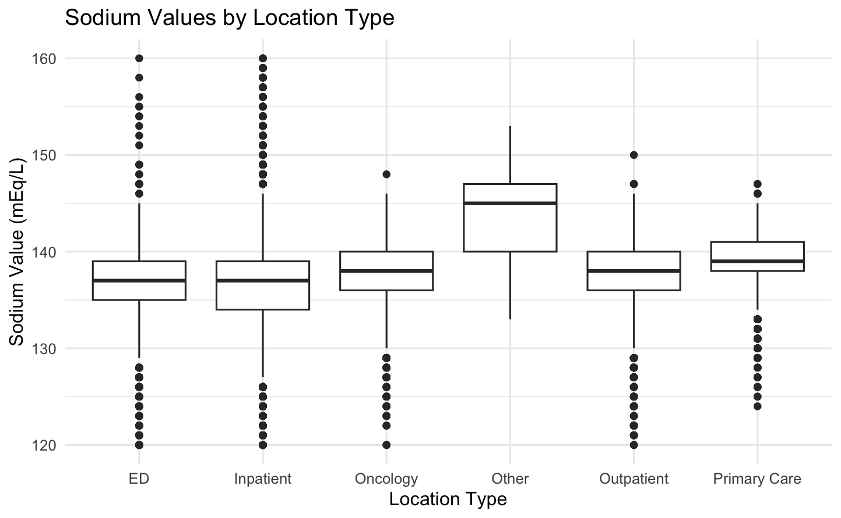
Example: sodium values by location
Outlier
Whisker length of 1.5 IQR (default)
(25% of data points above this value)
Third quartile
Numeric variable of interest
Interquartile range (IQR)
Median
First quartile
(25% of data points below this value)
Qualitative variable

Slide 14
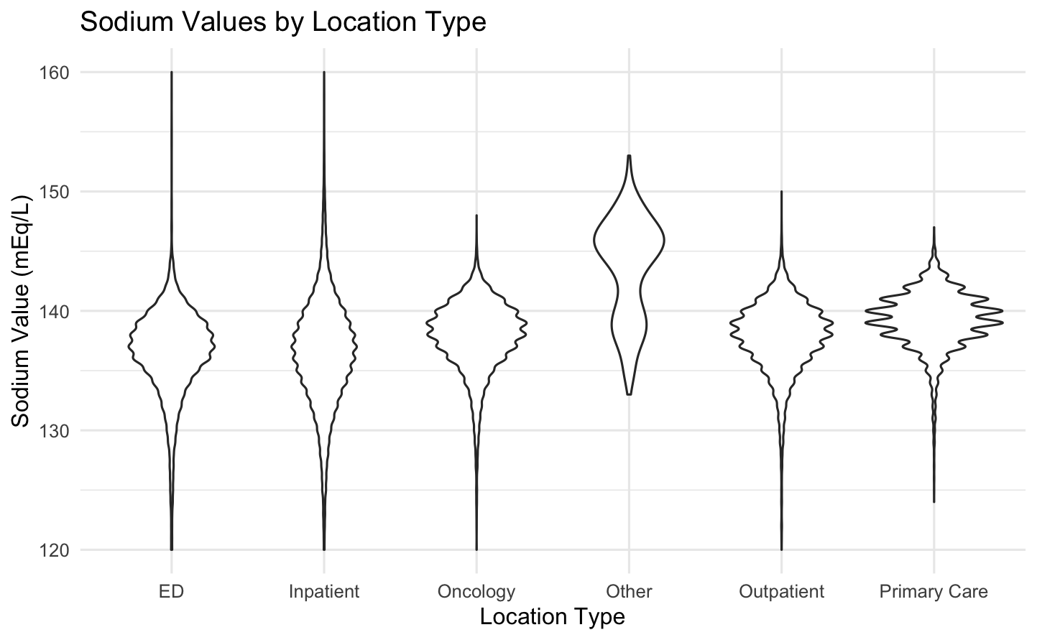
Violin plots better represent the underlying density distribution

Slide 15
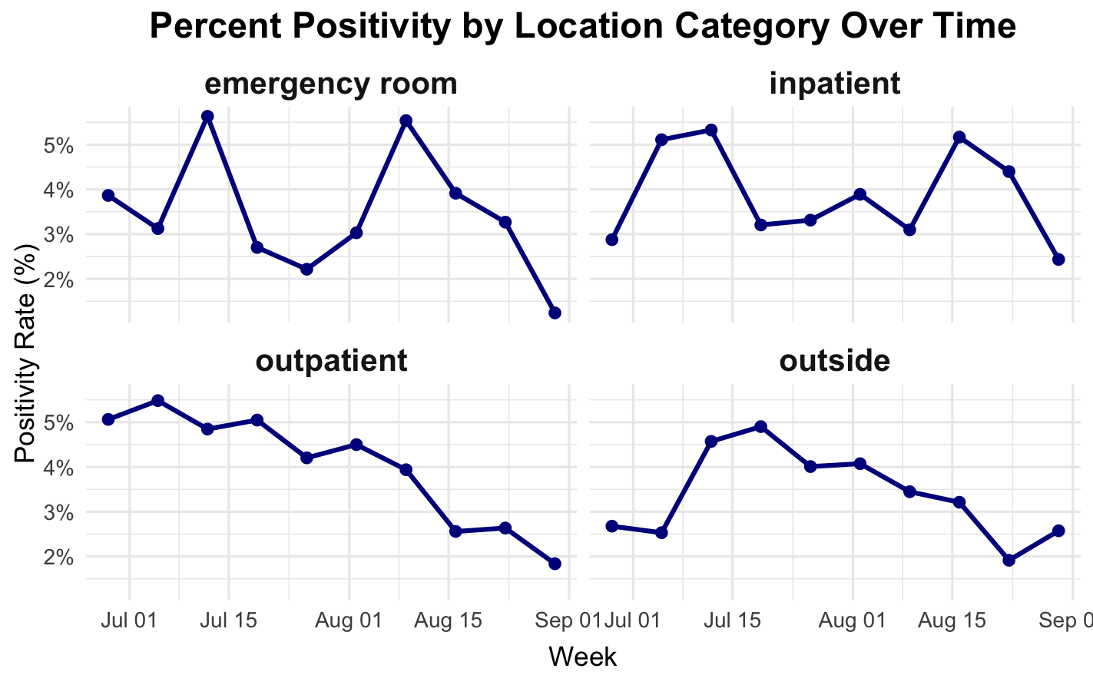
A small multiple can be invaluable in exploratory data analysis
Notes:
Series of graphs or charts using the same scale and axes to support easy comparison

Slide 16
Facet functions create subplots of a data frame based on one or more variables
ggplot(data = data_frame) +
geom_function(mapping = aes(mappings)) +
facet_grid(rows = vars(variable), …)
Create subplots based on variable
Can alter scales or labels
Notes:
So let’s recap. To make any kind of graph, you start with the template and…
** Pick a tidy data frame (this contains the data you want to plot),
** Pick a geom function (this is the type of plot you want to create), and
** Write aesthetic mappings (this is where you map data elements to x/y position, color, and possibly other graphical features)

Slide 17
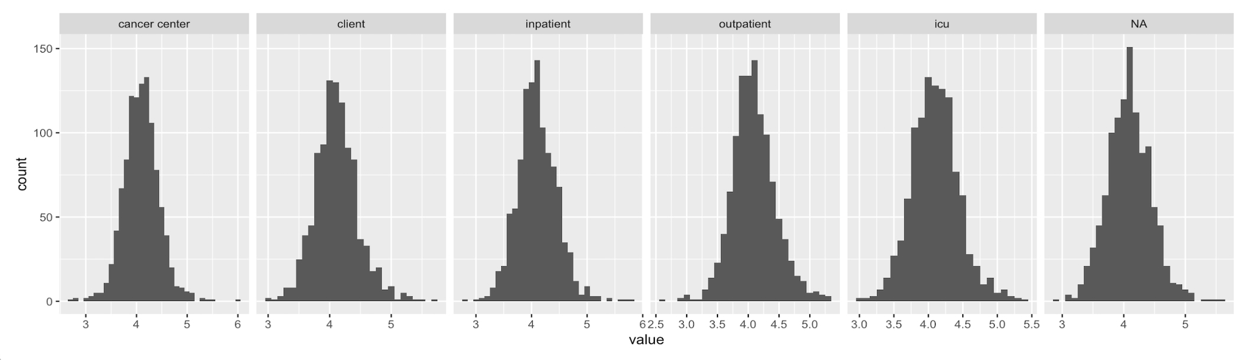
ggplot(data = k_data) +
geom_histogram(mapping = aes(x = value),
binwidth = 0.1) +
facet_grid(cols = vars(pat_type),
scales = “free”)

Slide 18
Compare & relate
Goal is to show differences, trends over time, relationships between variables, and uncertainty, identify patterns
Consider different data types and their relationships
Choose visualization that most effectively displays the desired comparison or pattern
Notes:
Comparing data and examining relationships

Slide 19


consider types of data
Quantitative (numeric)
Qualitative (categorical)
    - Ordered vs not
Notes:
Date time are special types of numeric? Or their own? See Patrick’s slides

Slide 20
Small Multiples for Comparisons
Exercise
Return to the Module 3 Exercises Quarto file in RStudio and complete the Small Multiples for Comparisons section.
Review the example for how to create a faceted plot with ggplot and then build a plot with 2 qualitative variables to better understand the underlying data.
Stop where it says Stop Here.
Notes:
Each prompt assumes the student attaches chem_subset.csv.
Variation 1: Minimal. This is the weakest version, but it is what many novices will type.
I'm new to R. I attached a CSV. Use ggplot to plot creatinine by age and creatinine by gender. Keep the code short and comment every line.
Variation 2: Specific. It names the columns and the data layout, which prevents most errors.
I'm new to R and have tidyverse installed. The attached CSV has one row per test per patient. The test column holds the test name, value holds the result, age is a number, and gender is text. Using only creatinine rows and dropping missing values, write short ggplot code for two plots. Plot 1: creatinine versus age. Plot 2: creatinine by gender. Put a comment on every step. List any assumptions you made.
Variation 3: Teaching. It asks Claude to explain the plot choice, so students learn why.
I'm a beginner in R. Attached is a lab data CSV in long format, with one row per test. Filter to creatinine and remove missing values. Then choose the best ggplot plot type for creatinine versus age and for creatinine by gender, and say in one sentence why you chose each. Keep the code short, comment every step, and tell me what I need to change to run it on my own computer.

Slide 21
Time’s up!!

Slide 22
Plotting in r – resources with code
https://r-graph-gallery.com/
https://r-charts.com/
https://www.data-to-viz.com/

Slide 23
Types of Comparisons
Change over time (trends)
  Point/line/run chart, ribbons for CIs, bar plot, table
  Use when: tracking levels, seasonality, shifts, interventions
Ranked or ordered values
  Bar plot, lollipop/dot plots, Pareto charts, table
  Use when: highlighting “top/bottom” contributors and order
Comparisons across categories
  Dot-whisker, box/violin + jitter, bar with CIs, bar plot, table
  Use when: displaying differences by groups
Proportions and rates (part-to-whole or success/failure)
  100% stacked bars, bar plot, pie chart, donut chart, table
  Use when: evaluating contributions of each part or progress to goal
Paired/pre–post or matched observations
  Slope or paired estimation plot, dumbbell plot, spaghetti plot, table
  Use when: showing individual changes and the overall effect

Slide 24
Types of Relationships
Correlation or deviation between two quantitative variables
  Scatter (with fit), difference plot
  Use when: assessing correlation, fit function, or bias
Spatial relationships
  Choropleth, symbol/heat maps
  Use when: values are tied to locations or regions
Multivariate patterns
  Heatmaps, correlation matrices, small multiples
  Use when: scanning many variables or facets at once
Hierarchies / taxonomies
  Dendrogram/tree graph, radial charts, treemaps
  Use when: representing qualitative-qualitative associations

Slide 25
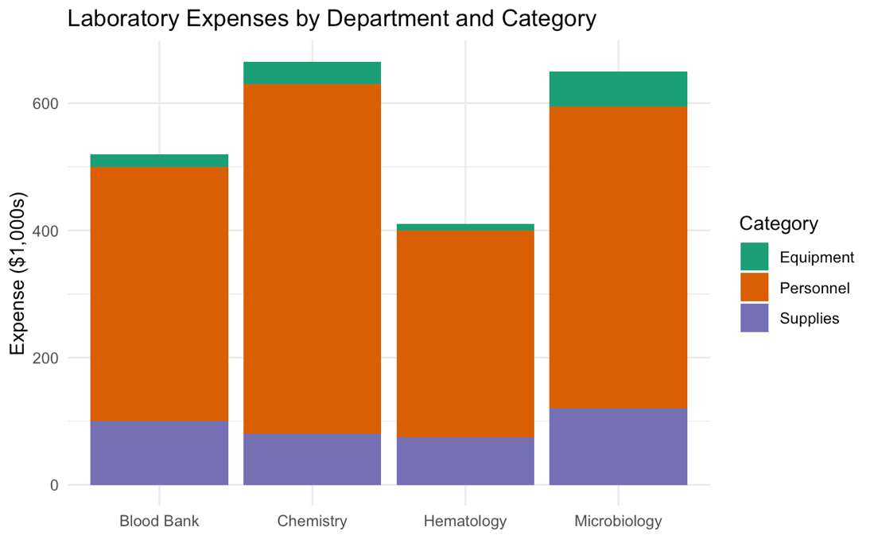
Which is better: Table vs plot?
Poll
Which lab spends least on supplies?
How much more does Micro spend on equipment than Blood Bank?
Notes:
Notice that a table was an option in all of the examples on the previous slide. One of the first questions to consider in data visualization is should you use a table to display data

Slide 26
Time’s up!!

Slide 27
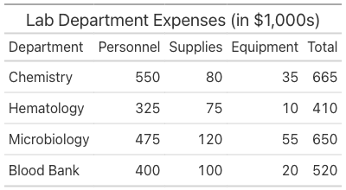
Which is better: Table vs plot?
Poll
Which lab spends least on supplies?
How much more does Micro spend on equipment than Blood Bank?
Notes:
Notice that a table was an option in all of the examples on the previous slide. One of the first questions to consider in data visualization is should you use a table to display data

Slide 28
Time’s up!!

Slide 29

Which is better?
Notes:
How many people got the same answers from both plot and table? Did you get answers from the plot vs the table?

Slide 30
When to display data in a table?
If one or more of the following are true, use a table:
Users will look up one or more individual values
Purpose is for one-to-one comparisons vs focused on finding patterns in data
Precise values are required (i.e., show multiple decimal places)
The display includes quantitative values with more than one unit of measure
Users require summary and detailed values in the same display
The dataset being displayed is sparse (e.g., 5-10 values)

Slide 31
When to Choose a Plot?
Visualizing trends, relationships, distributions, uncertainty, and patterns in data sets
  Particularly when working with 2 or more variables
Conveying a high-level overview of data for quick insights
Visualizing large datasets

Slide 32
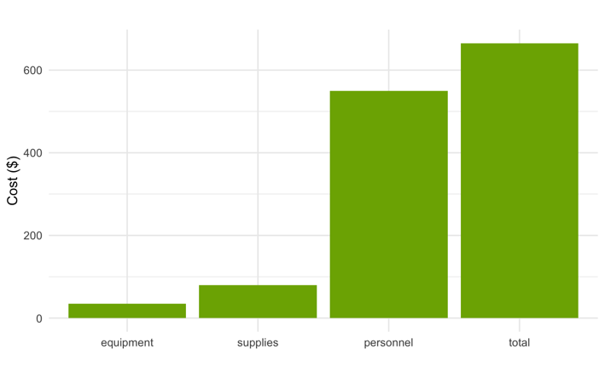
Bar plots Compare values across categories
Bar represents quantity or statistic for a categorical variable
Broadly applicable for visualizing individual values and for making comparisons by groups
Many variations available
Not best choice for continuous data

Slide 33

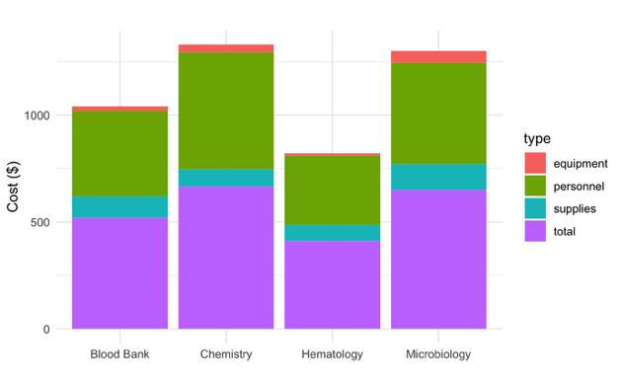
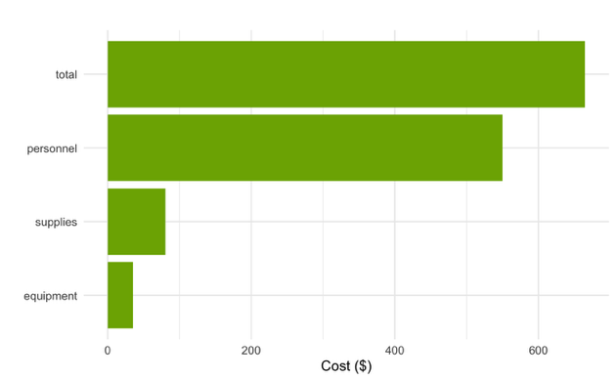
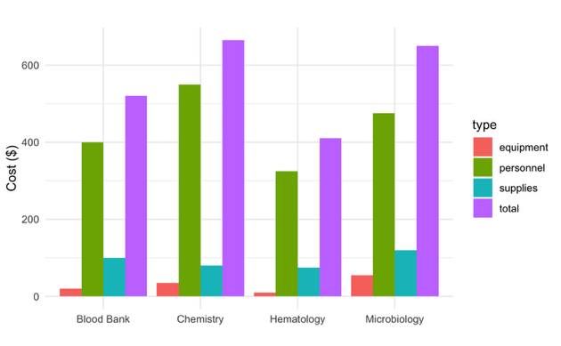
Examples: Lab costs by category
Categorical variable of interest 2
Numeric variable of interest
Categorical variable of interest
Notes:
may show stat (count) or actual value

Slide 34
Caution when using Bar plots for continuous data -- may mask important aspects
https://knowablemagazine.org/content/article/mind/2019/science-data-visualization

Slide 35
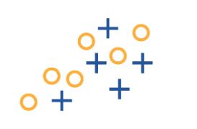
Scatterplots show relationships between quantitative variables
2 separate variables represented on x- and y-axes
Each dot represents a single data point or transaction
Lab context: each dot is a single sample with two variables (e.g. methods)

Slide 36
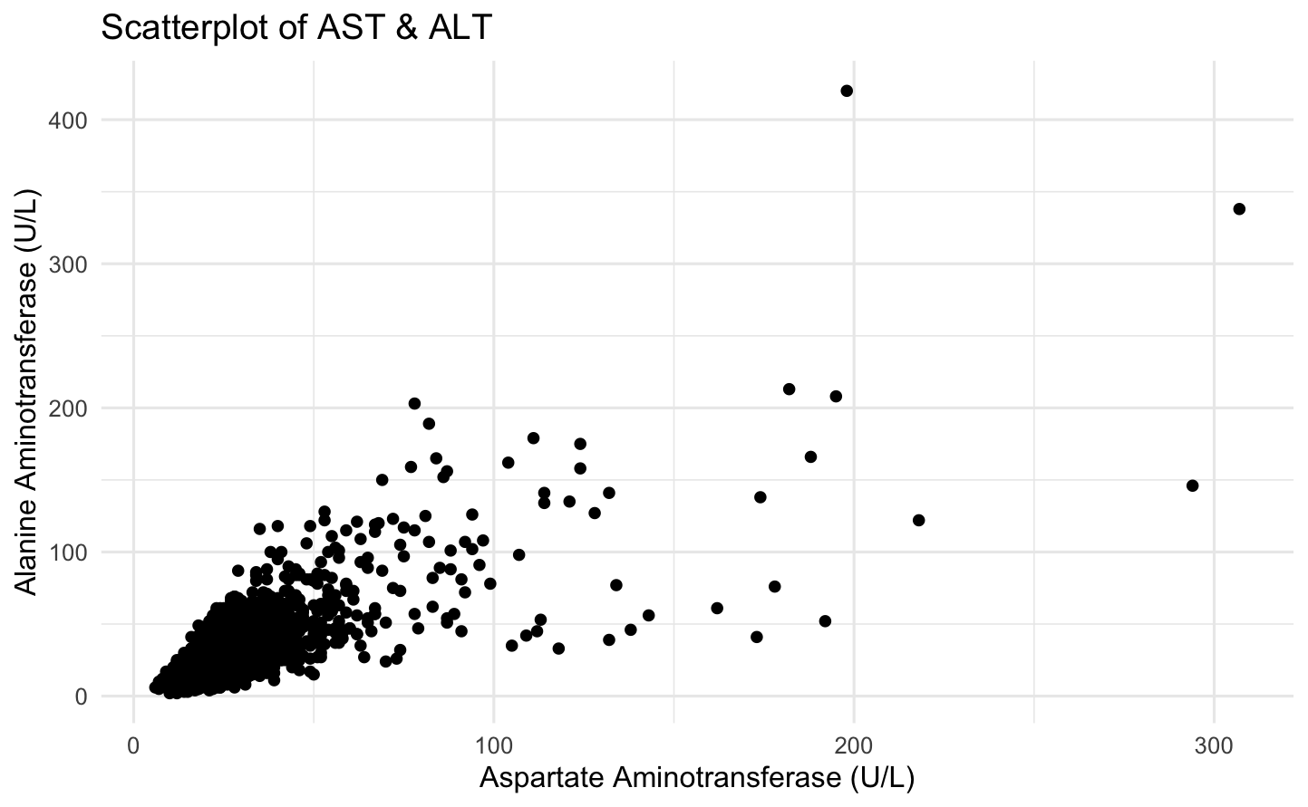
Example: correlation between liver enzymes
High density may obscure number of observations
Single observation
Numeric variable of interest 2
Numeric variable of interest 1

Slide 37
quantitative relationships
Exercise
Return to the Module 3 Exercises Quarto file in RStudio and complete the Quantitative Relationships section.
Review the example for how to create a scatterplot with ggplot and then build your own comparing 2 quantitative variables. Add a third variable to the plot, with Claude’s assistance, if needed.
Stop where it says Stop Here.
Notes:
Each prompt assumes the student attaches chem_subset.csv.
Variation 1: Minimal. This is the weakest version, but it is what many novices will type.
I'm new to R. I attached a CSV. Use ggplot to plot creatinine by age and creatinine by gender. Keep the code short and comment every line.
Variation 2: Specific. It names the columns and the data layout, which prevents most errors.
I'm new to R and have tidyverse installed. The attached CSV has one row per test per patient. The test column holds the test name, value holds the result, age is a number, and gender is text. Using only creatinine rows and dropping missing values, write short ggplot code for two plots. Plot 1: creatinine versus age. Plot 2: creatinine by gender. Put a comment on every step. List any assumptions you made.
Variation 3: Teaching. It asks Claude to explain the plot choice, so students learn why.
I'm a beginner in R. Attached is a lab data CSV in long format, with one row per test. Filter to creatinine and remove missing values. Then choose the best ggplot plot type for creatinine versus age and for creatinine by gender, and say in one sentence why you chose each. Keep the code short, comment every step, and tell me what I need to change to run it on my own computer.

Slide 38
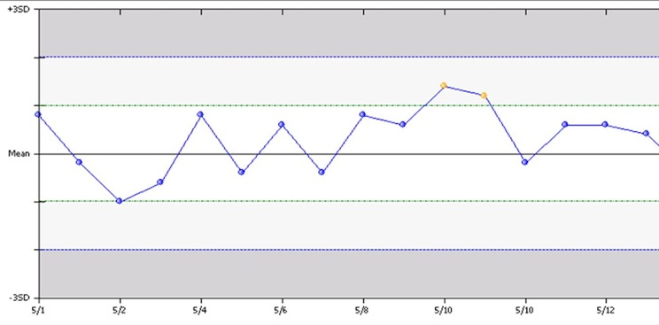
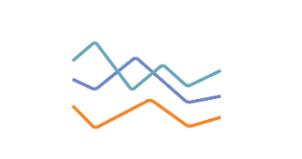
Line charts help visualize trends over time
Another representation of 2 separate variables, with one being ordered
Ordered variable most commonly = time
Data points connected to help visualize change across the ordered variable
Levey-Jennings Chart

Slide 39
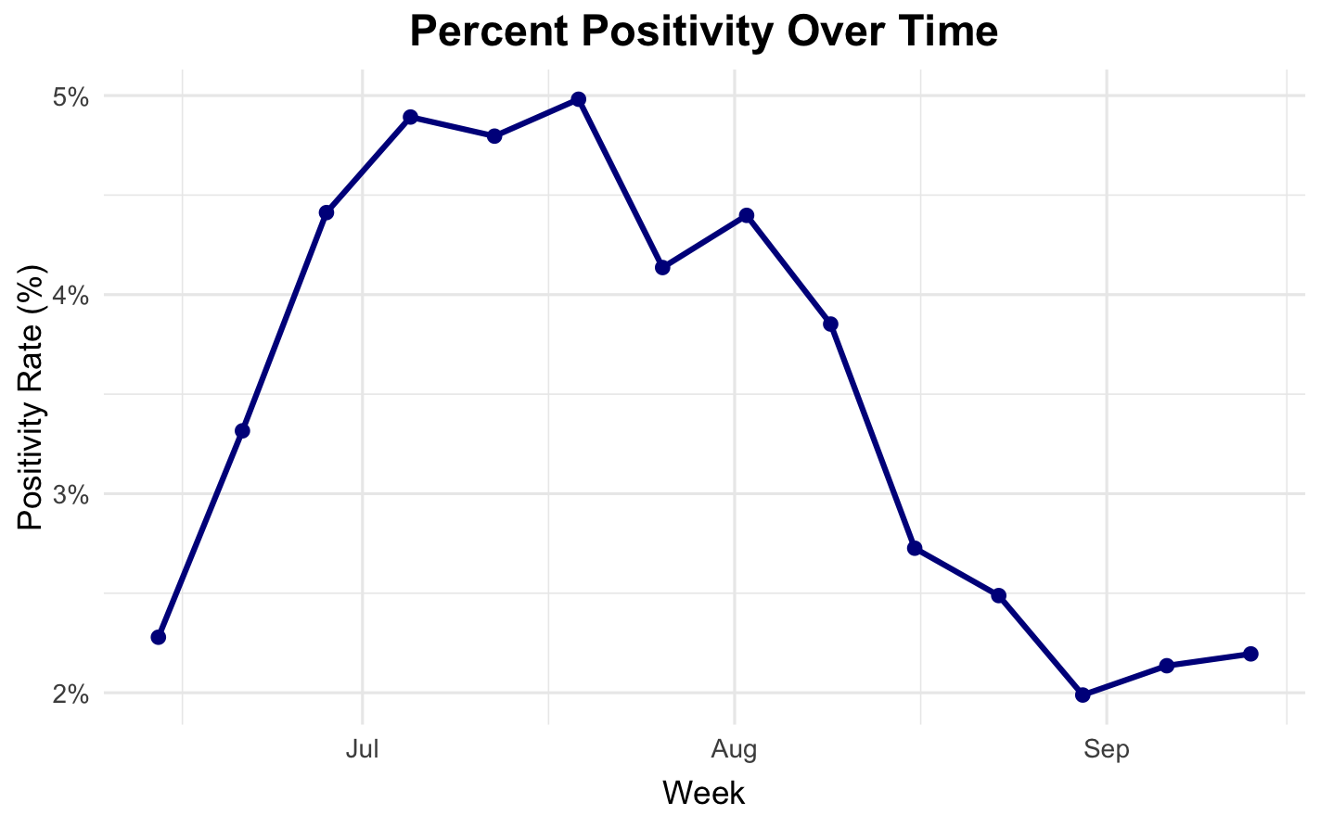
Example: SARS-CoV 2 positivity rates over time
Single observation
Numeric variable of interest
Time variable
Notes:
Call out that line shows progression

Slide 40
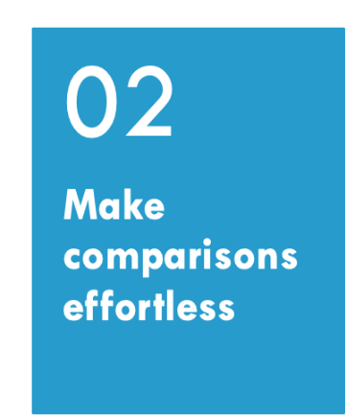
What is the key message for the audience?
  Focus the content for this purpose
How can you make it more obvious?
  Refine graphic and display elements
01

Slide 41
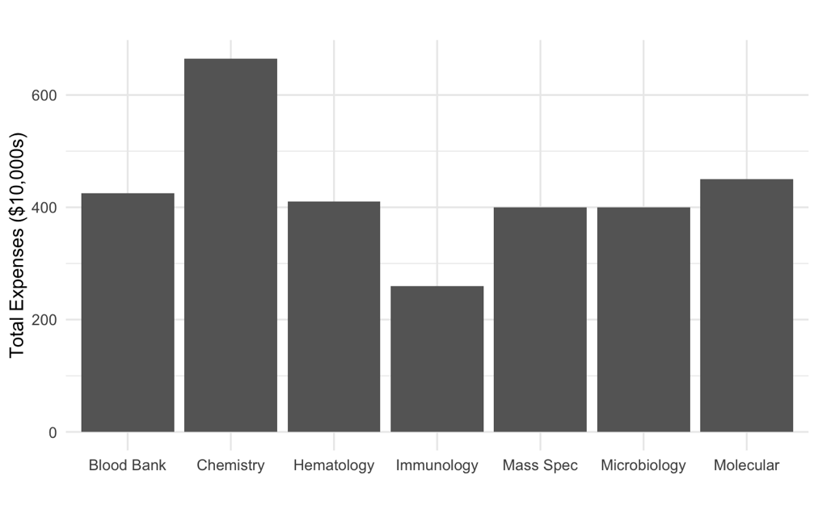
How to make comparisons effortless?
Poll
Which labs have the highest and lowest expenses?
What can we change to make comparisons easier for this bar plot?
Notes:
Make comparisons effortless
Sort categories, align/standardize axes across panels, use small multiples, and direct labels instead of hard-to-scan legends. Always show denominators.
Ex: 100% stacked bars of positivity by service, sorted high→low with percent labels.
Answers: sort or add color, add labels directly, rotate

Slide 42
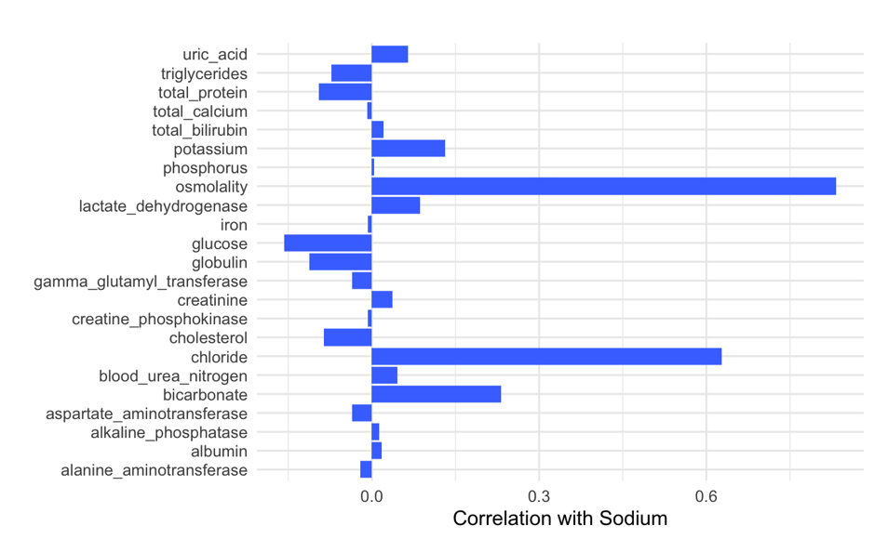
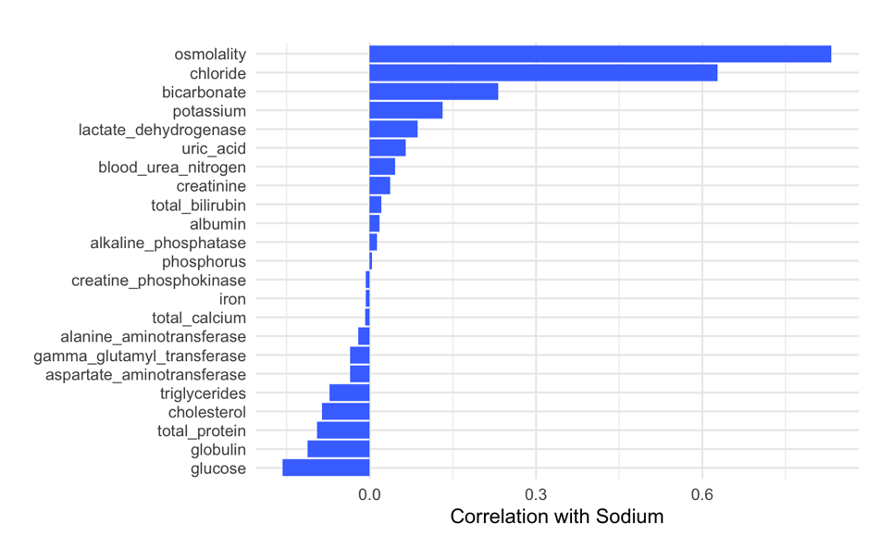
Sorting categories by the metric is better
Notes:
How many people got the same answers from both plot and table? Did you get answers from the plot vs the table?

Slide 43

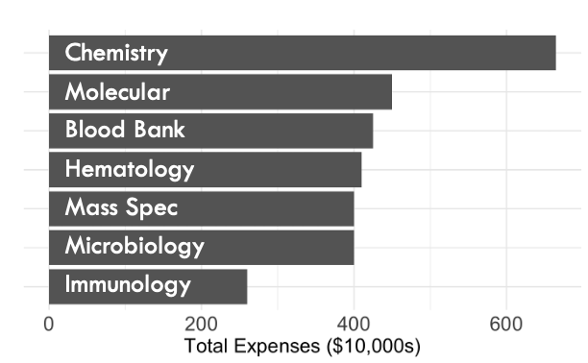
Which is better?
Poll
Notes:
How many people got the same answers from both plot and table? Did you get answers from the plot vs the table?

Slide 44
Use LAYOUt & scales effectively
Sort categories by the metric (e.g., high→low) and keep the same order across panels
Use consistent axes across small multiples; align zero baselines
Keep aspect ratios that don’t exaggerate slopes; avoid dual y-axes and 3D

Slide 45
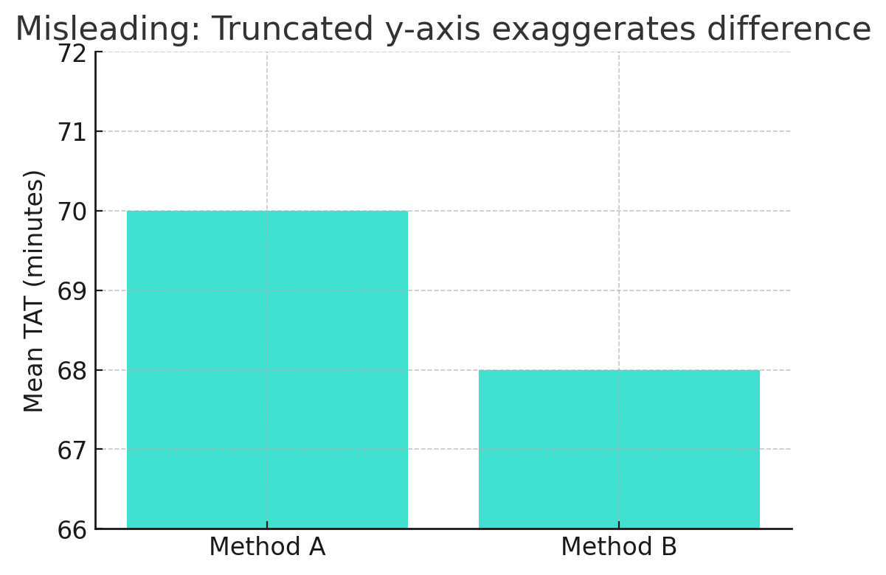
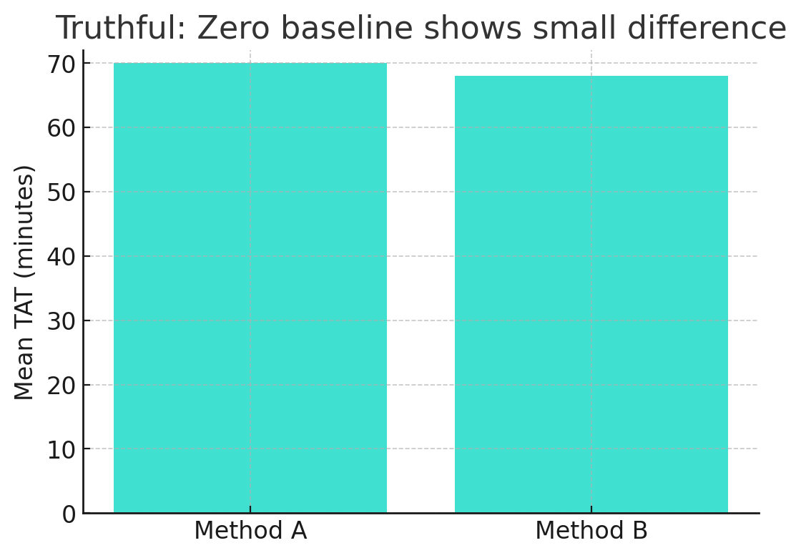
Truncated SCALES can be misleading
Better: Truncated axis but direct label avoids wrong conclusion
The mean TAT difference is 2 min
Notes:
Start bar charts at zero, avoid dual y-axes and 3D, choose sensible binning/smoothing, and keep aspect ratios that don’t distort trends.
Ex: QC run charts with consistent y-limits across instruments/lots.

Slide 46
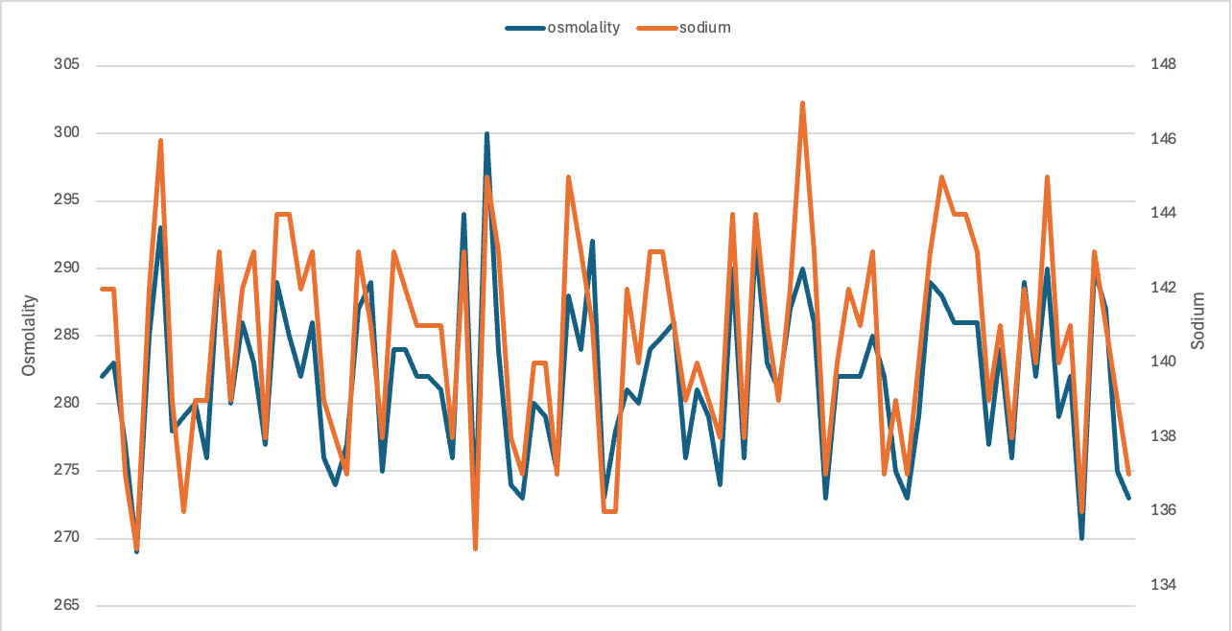
Always avoid Dual y axes
Why do this?
Same units but different magnitude
Different units
Problems:
Data to axis match is often not clear
Crossing lines and changes can be misleading
Changing scales may alter interpretation
Notes:
Start bar charts at zero, avoid dual y-axes and 3D, choose sensible binning/smoothing, and keep aspect ratios that don’t distort trends.
Ex: QC run charts with consistent y-limits across instruments/lots.
akj

Slide 47
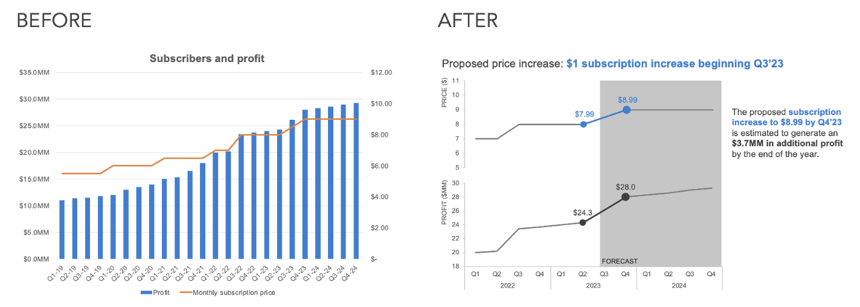
Try A better alternative
https://www.storytellingwithdata.com/blog/declutter-a-dual-y-axis-chart
Notes:
Other options are side-by-side, stacked with reference, and index plots

Slide 48
Normalize & provide reference
Show rates/percentages (with denominators) when group sizes differ
Add benchmarks (targets, medians) or difference-from-baseline views
Use per-unit scaling (e.g., per 1,000 tests) to put groups on comparable scales
Direct-label series/bars; minimize legend lookups
Put units in axis titles; add n and confidence intervals where relevant
Annotate key events (intervention, lot swap) right on the plot

Slide 49
Reduce clutter & clarify
Limit categories; group “other” or use small multiples instead of one crowded chart
Use light gridlines, short tick labels, and concise titles/subtitles, remove unnecessary titles and labels
Avoid rainbow palettes; use color purposefully to highlight comparisons
Apply transparency if data density is high

Slide 50
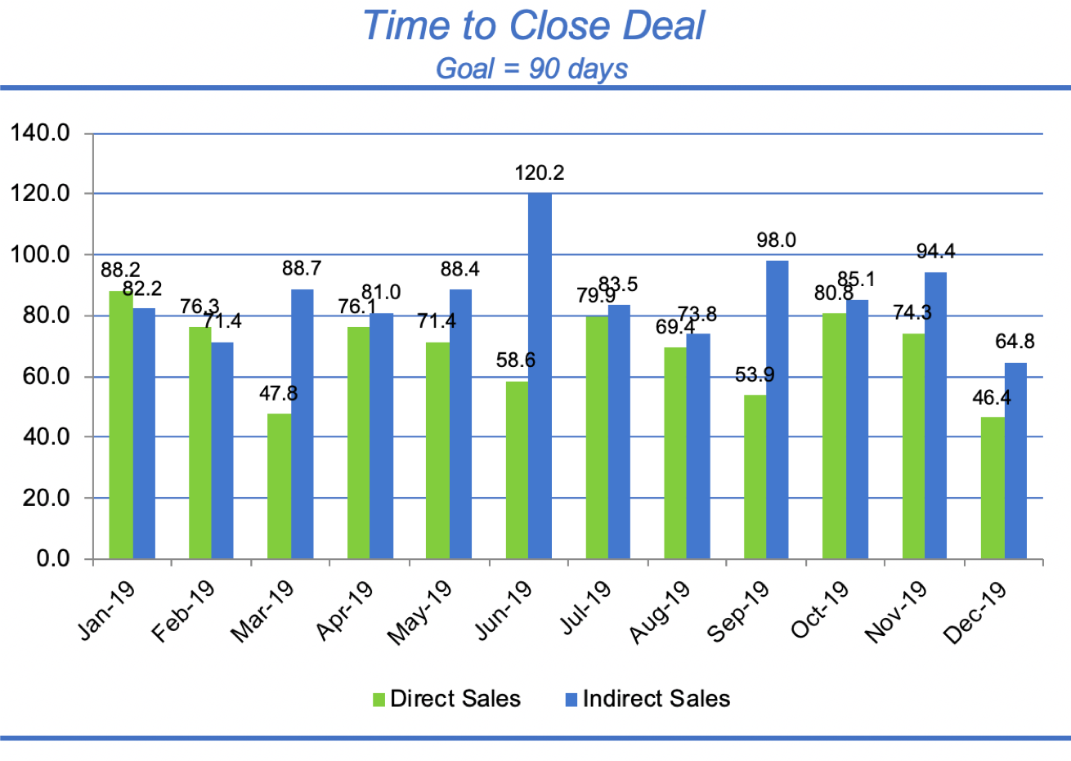
What is going wrong here?
Poll
doc
0.00817
bashful
happy
grumpy
sneezy
dopey
sleepy
0.00624
https://www.storytellingwithdata.com/blog/declutter-a-dual-y-axis-chart
Notes:
How many people got the same answers from both plot and table? Did you get answers from the plot vs the table?

Slide 51
Show more than averages
Replace mean ± SD bars with dot (+ CI), box/violin + jitter, or difference plots
Offer toggles (absolute vs %), tooltips for exact values, and “show table” for audit

Slide 52
How to make comparisons effortless?
Start with the right visualization and then refine it:
focus, sort, align, label directly, normalize fairly, and show uncertainty

Slide 53
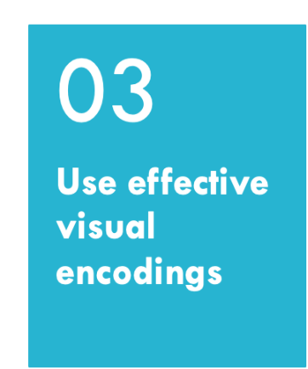
How can visual encoding help or harm visualization effectiveness?
What are visual elements?
01

Slide 54
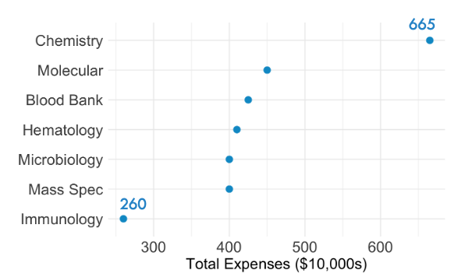
Which is better?
Poll
Notes:
How many people got the same answers from both plot and table? Did you get answers from the plot vs the table?

Slide 55
Visual channels can encode information
Use visual attributes to make aspects stand out or encode additional information making it easier to understand, compare, and retain
Commonly used elements: size, shape, color hue and intensity, length, and position
Most humans perceive these quantitatively to different degrees and many not well at all

Slide 56
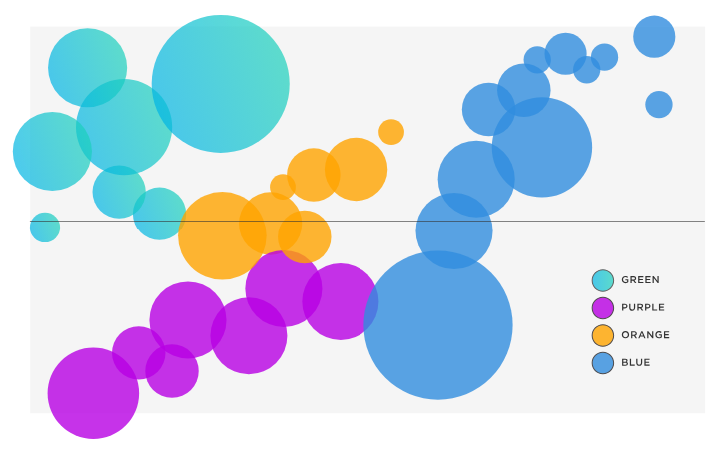
How well can we perceive relative area?
Poll
Compared to the circle on the left (A), how much bigger is the area of the circle on the right (B)?
B
A
Notes:
Answer is 12 i

Slide 57
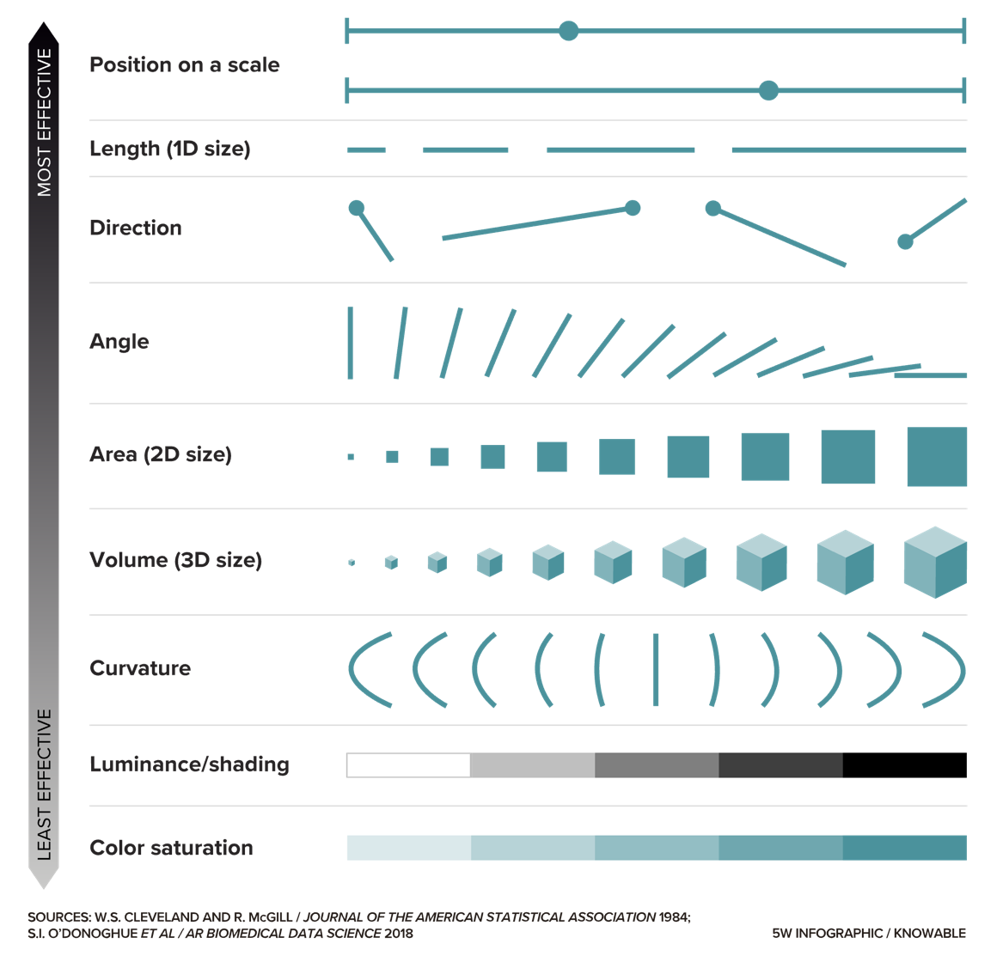
Effectiveness of Visual Elements
This is why data viz experts HATE pie charts, donut charts, and use of 3D!!
https://knowablemagazine.org/content/article/mind/2019/science-data-visualization
Notes:
Cleveland & McGill’s hierarchy of graphical perception

Slide 58
Effective use of visual channels
Match data type to channel and perceptual strength
  Nominal (categories): color hue or shape
  Ordinal (ordered): color lightness or position
  Quantitative: position on a common axis (best), then length; avoid area/volume for precise comparisons
Combine channels wisely
  Favor separable pairs (e.g., color + shape) over interfering ones (length + area)
  Use redundant encoding to reinforce meaning and improve accessibility
Aim for simplicity and clarity
  Use the minimal number of encodings necessary
  Avoid visual clutter and 3D effects

Slide 59
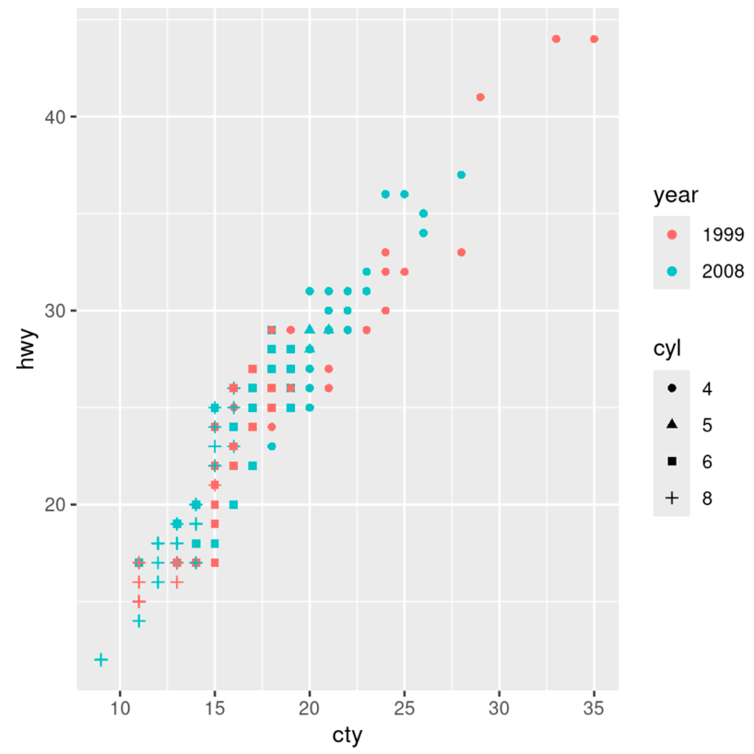
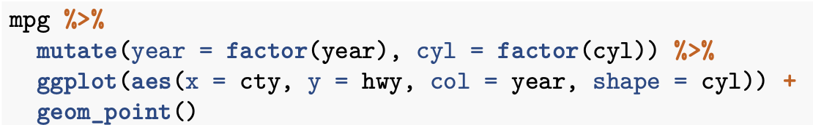
R Example from MSACL DS101
Data variable
Columns to plot on x and y axes
Chart type
Visual encoding for color and shape

Slide 60

How to most effectively use color?
  Improve accessibility
  Fast and accurate interpretation
How to improve readability?
01

Slide 61


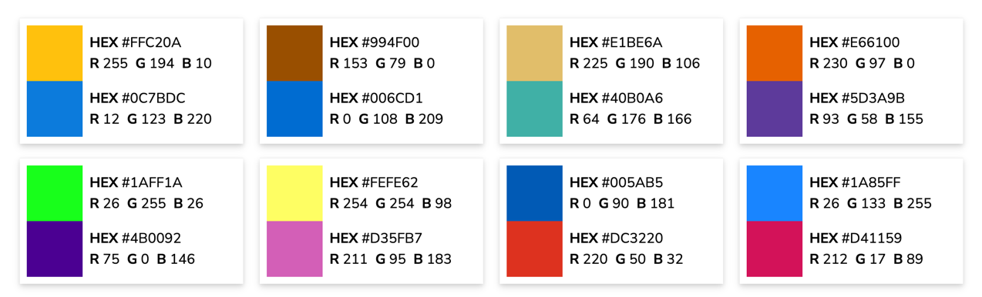
Colorblind Friendly Palettes
Colorblind Friendly Pairs
Notes:
Shannon

Slide 62

How well can we perceive color Intensity?
Poll
How much darker are the rectangles on the left than those on the right?
Notes:
The rectangles in this image are all the exact same shade of gray but look vastly different depending on the color that surrounds them. This phenomenon, known as simultaneous contrast, can cause readers to misinterpret the values represented by colors on a graphic.
From

Slide 63
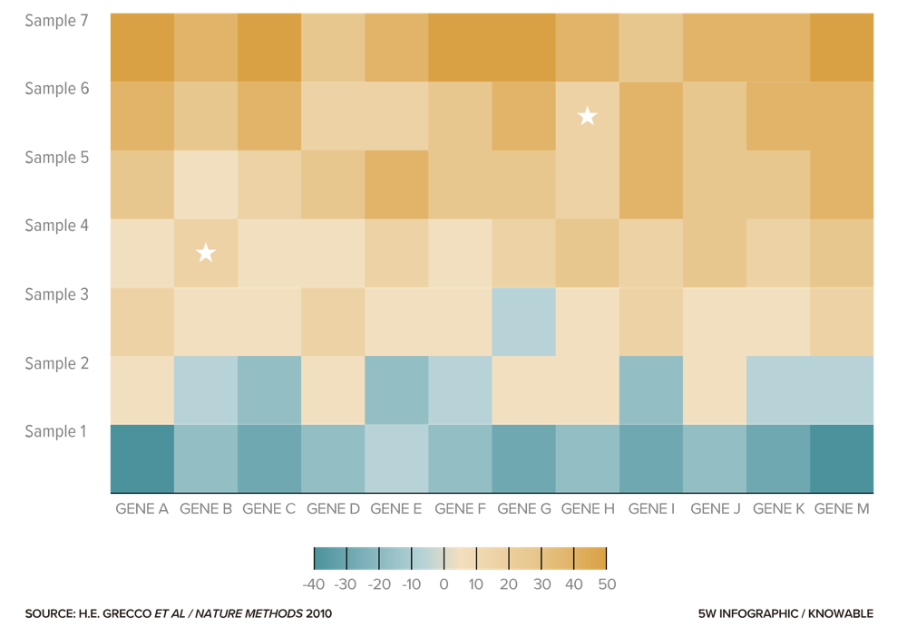
Simultaneous contrast can make heatmaps tricky to interpret
What are the values for
Sample 4, Gene B
Sample 6, Gene H
Notes:
Optical Illusions above – same star shades and greyscale shades
How much darker is the rectangle on the left vs on the right??? Neither – same color.

Slide 64
Best Use 0f color and intensity
Use Color Purposefully
  Apply color to encode necessary aspects
  Avoid using too many colors at once
Ensure Accessibility
  Choose color palettes that remain clear for people with color vision deficiencies
  Reinforce color encodings with labels, patterns, or shapes
Maintain Contrast and Consistency
  Ensure sufficient contrast between colors and background
  Use consistent color assignments across multiple charts to prevent confusion
  Consider cultural or standard associations with color

Slide 65
Make it easier for everyone to read
Select appropriate font, size, and page flow
  Use appropriate text size
  Choose fonts with high legibility
  Apply bold and CAPS to add emphasis
  Layout visual flow as people normally take in information from a page
Add elements for alternative readers
  Consider alternative text descriptions and formats for screen reader compatibility
  Limit interactivity and customization or make accessible by keyboard and screen reader users

Slide 66
Data visualization best practices
Match visual to purpose & data type
01
Make comparisons effortless
02
Use effective visual encodings
03
Design for readability & accessibility
04

Slide 67
Let’s put it to practice
Exercise
Return to the Lesson 3 Exercises Quarto
Review the graphs you made during the last 2 exercises (Small Multiples and Quantitative Comparisons) – how might you improve them?
Using Claude for assistance, optimize the 2 plots you created in those previous exercises, considering best practices to make comparisons effortless and considering visual encodings.

Slide 68
Example prompts
Exercise
A. I'm new to R. I attached a CSV. Use ggplot to plot creatinine by age and creatinine by gender. Keep the code short and comment every line.
B. I'm new to R and have tidyverse installed. The attached CSV has one row per test per patient. The test column holds the test name, value holds the result, age is a number, and gender is text. Using only creatinine rows and dropping missing values, write short ggplot code for two plots. Plot 1: creatinine versus age. Plot 2: creatinine by gender. Put a comment on every step. List any assumptions you made.
C. I'm a beginner in R. Attached is a lab data CSV in long format, with one row per test. Filter to creatinine and remove missing values. Then choose the best ggplot plot type for creatinine versus age and for creatinine by gender, and say in one sentence why you chose each. Keep the code short, comment every step, and tell me what I need to change to run it on my own computer.
Notes:
Note about uploading data files! This is synthetic data so we can do it here.

Slide 69
Time’s up!!

Slide 70
What did you improve about your graph(S)?
Poll

Slide 71
Excel is not a great visualization tool
Very easy to make bad visualizations using defaults
  A lot of ”chart junk”
  Poor layouts and graphic options
Not very easy to make customizations

Slide 72
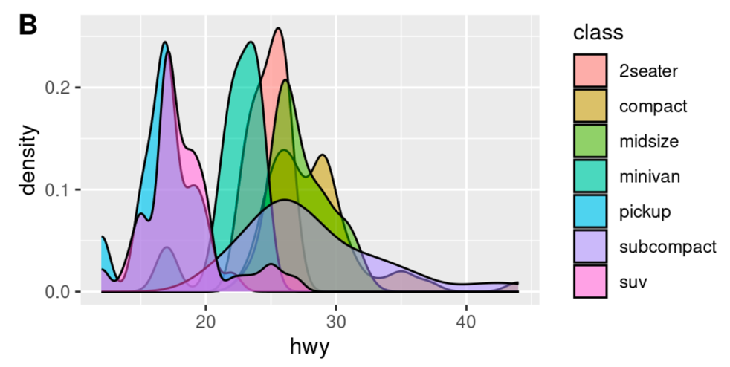
It’s just a tool – R can make bad plots too!
And it can do it faster and without getting tired!

Slide 73
summary
Creating effective visualizations requires knowledge of best practices
Default settings in visualization tools likely require modification
When communicating with visuals, keep these concepts in mind
    Select the best visual for your purpose and data type(s)
    Make comparisons and conclusions easy for the audience
    Use visual encodings that are effective
    Include elements that enhance readability and accessibility

Slide 74
Lesson Goals
Identify types of common data visualizations that are most appropriate given the types of data available and the goal of the analysis
Lesson Objectives
Describe at least 2 scenarios in which a plot is more effective than a table in demonstrating relationships between variables in a data set
For each possible combination of data types, identify a type of plot that will effectively illustrate the relationship between two variables
List 2 types of plots that can illustrate statistical uncertainty when comparing numeric values between groups.

